Slide 1
Software Development Tools
COMP220/COMP285
Sebastian Coope
Eclipse and JUnit:
Creating and running
a JUnit test case
These slides are mainly based on “Java Development with Eclipse” – D.Gallardo et al., Manning Publications., 2003

Slide 2
Eclipse and JUnit
Eclipse’s JDT provides a powerful, flexible environment for
  writing, running, and debugging Java code.
But developing quality software requires more than that.
Here we examine JUnit as Eclipse’s integral testing framework (plug-in).
Later, we will consider Ant plug-in in Eclipse.
Notes:
Because of its open and extensible nature, Eclipse easily accommodates tools (plug-ins) of all sorts.

Slide 3
Persistence project
Here we begin (but not finish!) developing a sample application :
  a lightweight persistence component that allows one to save data in files.
Persisting data means saving it, using some form of storage, so one can retrieve it later.
Our goal is to illustrate by a simple example how JUnit testing framework may be used in Eclipse during developing this application.
Notes:
more-or-less permanent

Slide 4
Junit concepts
Fixture
  A database table with a specific, known set of data
  Copying a specific known set of files
  Preparation of input data and setup/creation of fake or mock objects
Test case
  Test with given set of test data (e.g. fixture)

Slide 5
Persistence project summary
Class will provided the following
  Allow data to be saved a file using a numeric value as a key
  Allow data to be loaded from a file using a numeric value as a key
Interface
  void save(String filename,int key,Vector value)
  Vector load(String filename,int key)

Slide 6
Persistence project
The first step is to create a new Java project, called
Persistence
with choosing the option:
“Create separate folders for sources and class files”.
(You already know how to do this.)
Create under src directory in this project:
  the stub class FilePersistenceServices.java
  with some stub methods (see below),
  but without the main() method
  under the new package
  org.eclipseguide.persistence
  or, in the labs, it should be your personalised package:
  surname.name.ID123456.persistence
  check Generate Comments
  click Finish
Notes:
Persistence
FilePersistenceServices
org.eclipseguide.persistence

Slide 7
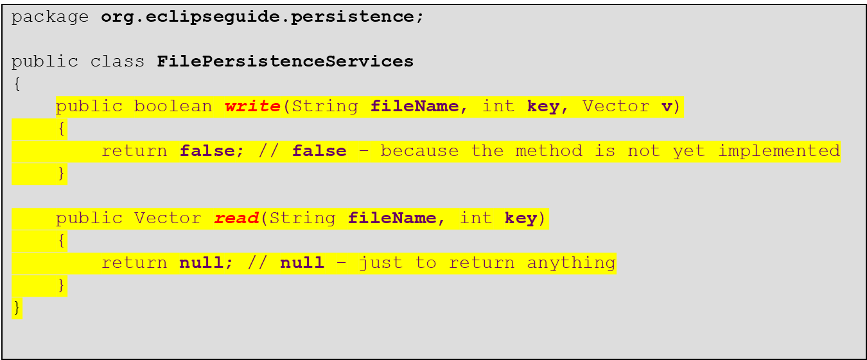
FilePersistenceServices.java
Extend the resulting Java class in the editor as follows:
write() and read() (stub) methods are intended to
  insert a key -numbered vector record v into a file with returning true , if successful,
  retrieve a vector record from a file by its key number.
Notes:
public static boolean write(String fileName, int key, Vector v)
{
return false; // false – because the method is not yet implemented
}
public Vector read(String fileName, int key)
{
return null; // null – just to return anything
}

Slide 8
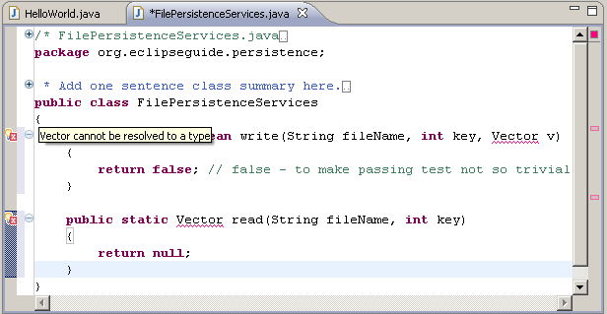
FilePersistenceServices.java
Note Red syntax error marks on the right and left hand side of the editor

Slide 9
FilePersistenceServices.java
Red marks on the right and left hand side of the editor "say":
"Vector cannot be resolved to a type".
In fact, this is because
  there is no import statement for the Vector class.
The easiest way to add it consists in using Eclipse’s Quick Fix feature:
  Click on one of the light bulbs (on left margin of the Editor)
  Double click on suggested fix:
  Import 'Vector' (java.util)

Slide 10
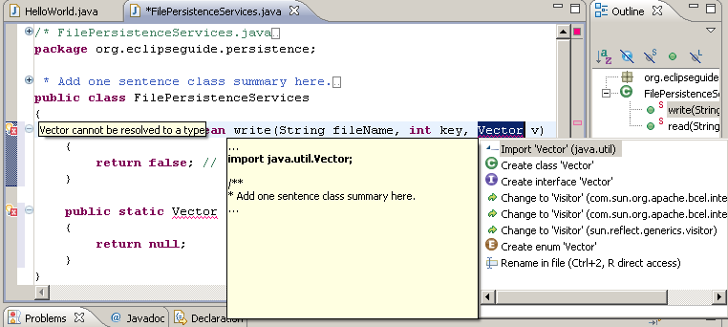

FilePersistenceServices.java
double-click
Click on a light bulb (left to the Editor)

Slide 11
FilePersistenceServices.java
This class should now be error-free because the above actions automatically generated new import declaration:
import java.util.Vector;
Tidy up and save the file:
  Right-click on the editor area and select
  Source->Format
  or do the same from the menu
  or use Ctrl+Shift+F
  Save the file.
Formatting and saving aren’t necessary, but they make some of Eclipse’s automated features work better.
Some yellow coloured warnings (not errors) remain which mean that in corresponding places Vector should be replaced with Vector<String> (Generic)
Notes:
we will ignore.

Slide 12
The JUnit testing framework in Eclipse
We are ready to create a test case :
  a special Java class called JUnit Test Case class.
It is normal to have
one test class for each class in the program
and to name them by adding the suffix Test to the class name:
  FilePersistenceServices.java – given source (stub) class;
  FilePersistenceServicesTest.java – corresponding test case;
The easiest way to create JUnit test case classes is using
  JUnit wizard in Eclipse.

Slide 13
Create test case stub by using the
JUnit wizard in Eclipse
Right-click on the file
FilePersistenceServices.java
in the Package Explorer and
Select
  New ->JUnit Test Case
See next slide
Notes:
Right-click on the file FilePersistenceServices.java and select New->Other.
Select
Java->JUnit->JUnit Test Case->Next
You will be asked (quite naturally!) to add JUnit library ‘junit.jar’ to the build path.
Click Yes.
(See next slide)

Slide 14
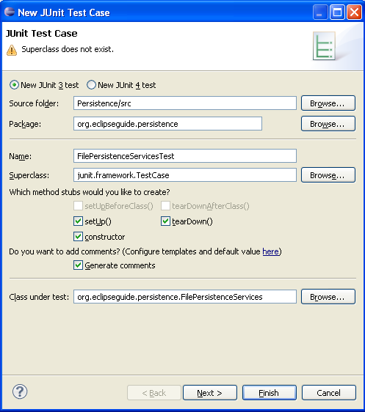
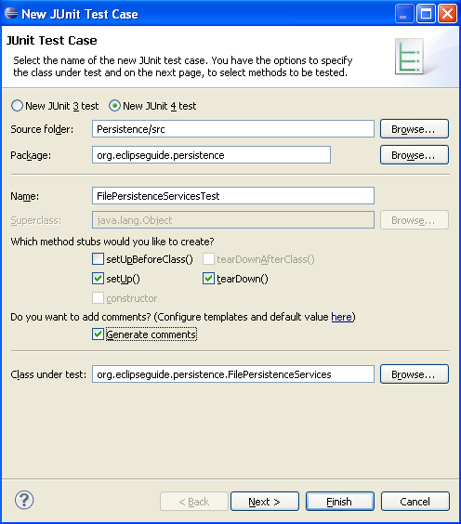
Create test case stub by using the JUnit wizard in Eclipse
Accept the default values for
  Source folder,
  Package,
  Name of test case, and
  Class under test.
Check options for Junit 4 and for creating stubs for setUp(), tearDown(), (and optionally Generate Comments).
Click Next.

Slide 15
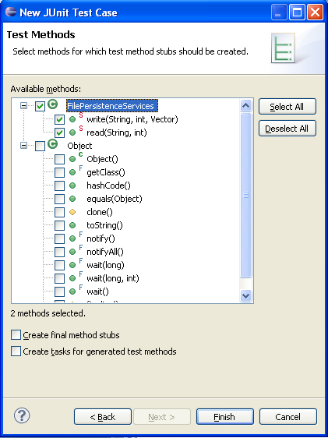
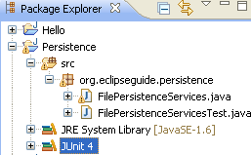
Create test case stub by using the JUnit wizard in Eclipse
In the next dialog box
check boxes for the FilePersistenceServices read() and write() methods to create stub test methods for each of them.
Click Finish.
Confirm adding Junit 4 library to the build path.
IF Junit 4 will not appear in Package Explorer under Persistence as here,
THEN see the second half of
Slide 47 from EclipseJava.ppt.

Slide 16
package org.eclipseguide.persistence;
import static org.junit.Assert.*;
import org.junit.After;
import org.junit.Before;
import org.junit.Test;
public class FilePersistenceServicesTest
{
@Before //Runs before each @Test method
public void setUp() throws Exception
{}
@After //Runs after each @Test method
public void tearDown() throws Exception
{}
@Test
public void testWrite()
{
fail("Not yet implemented");
}
@Test
public void testRead()
{
fail("Not yet implemented");
}
}
Importing the necessary
Junit4 classes
stub methods
for setUp() and
tearDown()
stub test methods
for testing
write() and
read()
The resulting test case stub created by the wizard

Slide 17
Further work on the test case stub
FilePersistenceServicesTest.java
Now we need to create a fixture:
  data and objects for which @Test annotated methods testWrite() and testRead() in a test case will be applied:
    The annotated by @Before and @After methods setUP() and tearDown() are provided to set up and clean fixtures,
    they are run by JUnit, respectively, before and after each @Test method (testXXX()).

Slide 18
Further work on the test case stub
FilePersistenceServicesTest.java
Declare Vector variable at the beginning of the test case class declaration
public class FilePersistenceServicesTest
{
Vector v1;
You will need to use Quick Fix light bulb to add Vector import statement.
Set up the fixture , Vector v1, as follows:
  public void setUp() throws Exception
  {
  services=new FilePersistenceServices();
  v1 = new Vector();
  v1.addElement("One");
  v1.addElement("Two");
  v1.addElement("Three");
  }
Notes:
Vector v1;
services=new FilePersistantServices();
v1 = new Vector();
v1.addElement("One");
v1.addElement("Two");
v1.addElement("Three");

Slide 19
Further work on the test case stub
FilePersistenceServicesTest.java
  In the most cases tearDown() method is unnecessary.
  But we can implement it to release v1 as
  In general, tearDown() is used to release system resources (probably expensive!) that might not otherwise be released.
Now, we are ready to run this test case in Eclipse.
  protected void tearDown() throws Exception
  {
  v1 = null; // release v1
  }
Notes:
v1 = null; // release v1

Slide 20
Running the JUnit tests in Eclips
Running the JUnit tests in Eclipse is similar to running a Java application:
  First make sure that the test case you want to run
  FilePersistenceServicesTest.java
  is selected – either in the editor or on the Package Explorer view.
  Select Run->Run As->JUnit Test
JUnit view is automatically added, covering Package Explorer view.
(See next slide)

Slide 21
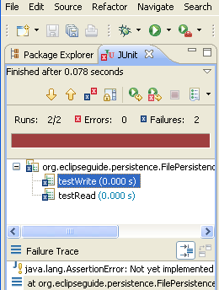
Running the JUnit tests in Eclips
Red bar turns green once your class passes all tests successfully.
Our tests do not pass.
  nothing strange!
  the tests fail by trivial reason: being “Not yet implemented ”
  more precisely: they are deliberately implemented to be failed
Further work both on the source file and on the test case is required.
Try to double-click
  on failed tests in JUnit view,
  on the second line of the Failure Trace,
  and also on various elements in Outline view.
This will lead you to corresponding places in the editor. (Very helpful!)
After viewing the test results, you can click on the Package Explorer tab to return this view on the top.
The JUnit test view.
Notice the red coloured bar!

Slide 22
Further work on the Test Case stub
Let us test whether read() and write() methods return reasonable values by using more general JUnit assert* methods (instead of fail()).
assert* methods will be further discussed in our lectures.
  The boolean write() method should return true if it succeeds in writing the values stored in the Vector into a file:
  public void testWrite()
  {
// fail("Not yet implemented");
  assertTrue("NOT WRITTEN???",
  services.write
  ("TestTable", 1, v1));
  }
Comment or
omit this line
Writing data
to file
should be
successful
file name
key
vector
Notes:
assertTrue("NOT WRITTEN???", FilePersistenceServices.write("TestTable", 1, v1));
were discussed formerly

Slide 23
Further work on the test case stub
  Analogously, for read() method we expect it to pass the following test:
  public void testRead()
  {
  services.write("TestTable", 1, v1);
  Vector w =
  services.read("TestTable", 1);
  assertEquals(v1,w);
  }
fail("Not yet implemented");
replaced with the following:
reading from a file should produce the same value which has been written into the file beforehand
expected
actual
Notes:
FilePersistenceServices.write("TestTable", 1, v1);
Vector w =
FilePersistenceServices.read("TestTable", 1);
assertEquals(v1,w);

Slide 24
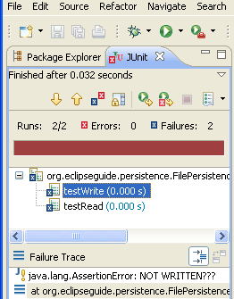
Running the JUnit tests in Eclips again
To re-run, click Run button
Our tests again do not pass!
Again try to double-click
  on failed tests in JUnit view,
  on the second line of the Failure Trace,
This will lead you to corresponding places in the editor.
For example, we can see that
  testWrite failed because of assertTrue which expects true. Our message "NOT WRITTEN???" helps to understand the reason.
  Now, select testRead. We see that it failed because of java.lang.AssertionError: expected:<[One, Two, Three]> but was: <null>.
All of this can help to understand the reason of test failures.
The JUnit test view appears.
Again red coloured bar!

Slide 25
Running the JUnit tests in Eclips
You can get a little instant gratification by
  changing the return value of the write() method in the FilePersistenceServices class from false to true and
  commenting out the whole testRead() method in FilePersistenceServicesTest class.
Selected code may be commented out or uncommented by Ctrl-/.

Slide 26
Running the JUnit tests in Eclipse
To re-run a selected Junit test case, click Run button
Now we see green bar:
  the only remaining testWrite() method succeeded (of course, by trivial reason).
Recover the original versions of our files by using Undo (Ctrl-Z).

Slide 27
Further testing-coding
Thus, two minimal tests and zero functionality!
But we should not expect anything else because the source code is just a stub.
Anyway, we have already seen how JUnit works in Eclipse.
To develop functionality of our source code, let us
  test and code at a finer level of detail.

Slide 28
Further testing-coding
To implement our methods
  boolean write(String fileName, int key, Vector v)
  Vector read(String fileName, int key)
we will need intermediate – helper methods
  vector2String()
  string2Vector()
This is an intermediate step to write/read vectors via their string representation into/from a file.

Slide 29
Further testing-coding
We intend to store data in a text file line-by-line for each record:
using comma-separated values (CSV)
Here "1","2",… serve as keys to locate a specific record.
E.g. [Antbook,Hatcher,Manning,2003] is vector or record saved into the file as a string under the key 2.
Each line in the file is a string to be created first by the method vector2String(Vector v, int key) which is not yet implemented.
Our string s1 considered below
  "1","One","Two","Three"
  "2","Antbook","Hatcher","Manning","2003"
  "3","Eclipse","Gallardo","Manning","2003"

Slide 30
Further testing-coding
According to test-first philosophy, let’s start with extending FilePersistenceServicesTest class:
  Add the following String s1 attribute under the Vector v1 attribute
String s1 = "\"1\",\"One\",\"Two\",\"Three\"";
    Recall that actually v1 = [One, Two, Three]
  Add new @Test method in FilePersistenceServicesTest class which we expect to pass:
  @Test
  public void testVector2String()
  {
  assertEquals(s1,
  FilePersistenceServices.vector2String(v1,1));
  }
expected
actual
Notes:
String s1 = "\"1\",\"One\",\"Two\",\"Three\"";
=============================
@Test
public void testVector2String()
{
assertEquals(s1,
FilePersistenceServices.vector2String(v1,1));
}

Slide 31
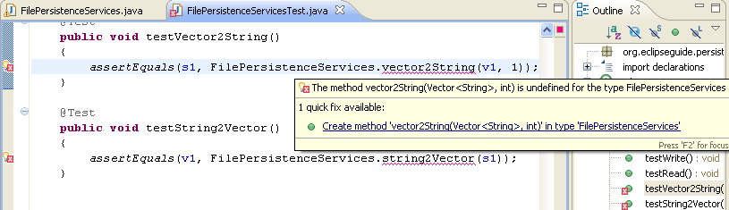
Further testing-coding
But now red sign and light bulb appear on the right and left boarders of the Editor view witnessing on a syntax error in the test class which uses non-existing yet method vector2String.
  Click on the light bulb which suggests to
    create automatically(!) the stub method vector2String(Vector v, int key) in the source file FilePersistenceServices.
  Agree with this suggesstion by double clicking, and
  Continue editing the resulting method as it is shown in the next slide with the goal for it
    to pass the above test.

Slide 32
vector2String() added to FilePersistenceServices
public String vector2String(Vector v, int key)
{
String s = null;
StringBuffer buffer = new StringBuffer();
// start with key in quotation marks and comma
buffer.append("\"" + Integer.toString(key) + "\",");
// add quote delimited entry
// for each element in Vector v:
for (int i = 0; i < v.size(); i++)
{
buffer.append("\"");
buffer.append(v.elementAt(i));
buffer.append("\"");
if (i != (v.size() - 1)) // if i is not last
{
buffer.append(","); // Add comma in case
} // of not last element
}
s = buffer.toString();
return s;
}
Do not forget to regularly format, Ctrl+Shift+F, and save your files.

Slide 33
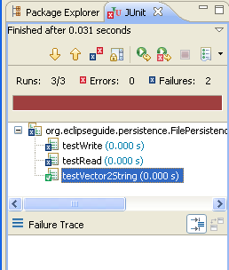
Further testing-coding
Run FilePersistenceServicesTest again using :
  the first two tests still fail,
  but the new third test passes!!!
  Indeed, we see the green tick and the empty Failure Trace
Not a complete success, but the new test
testVector2String() successfully passes!

Slide 34
Further testing-coding
  To implement string2Vector(String s), let’s first
  add the following new @Test method to FilePersistenceServicesTest
  suggests again to implement string2Vector() in the source file (as we are testing a non-existing method).
  We also need to use Java’s StringTokenizer class to
      parse any String s into tokens, and
      add each token to a Vector v as shown in the next slide:
  @Test
  public void testString2Vector()
  {
  assertEquals(v1,
  FilePersistenceServices.string2Vector(s1));
  }
expected
actual
Notes:
@Test
public void testString2Vector()
{
assertEquals(v1,
FilePersistenceServices.string2Vector(s1));
}

Slide 35
Further testing-coding
string2vector() added to FilePersistenceServices
public Vector string2Vector(String s)
{
Vector v = new Vector();
// use comma and double quotation mark as delimiters
StringTokenizer st = new StringTokenizer(s, "\",");
while (st.hasMoreTokens())
{
v.addElement(st.nextToken());
}
return v;
}
parsing string s
into tokens and
adding them to
vector v
E.g. string ""One","Two","Three"" transforms to vector [One,Two,Three].
suggests to import java.util.StringTokenizer;
Notes:
Vector v = new Vector();
// use comma and double quotation mark as delimiters
StringTokenizer st = new StringTokenizer(s, "\",");
while (st.hasMoreTokens())
{
v.addElement(st.nextToken());
}
return v;

Slide 36
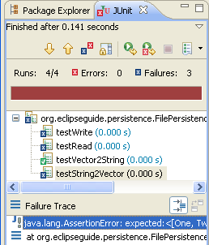
Further testing-coding
However, the test for string2Vector fails:
  Failure Trace in the JUnit view indicates that the comparison of
    the expected value v1 and
    the returned string2Vector(s1) are different:
java.lang.AssertionError:
expected:<[One, Two, Three]>
but was:<[1, One, Two, Three]>
CORRECT implementation of the method string2Vector() to make testString2Vector passing.
  Just ignore the initial token 1 (How? Think, it is easy!)
  Run the test again; it should succeed!

Slide 37
Further testing-coding
  Iimplement yourself another method
  in FilePersistenceServices class, but ...
  Preliminary write testGetKey() in FilePersistenceServicesTest classs:
  public int getKey(String s){???}
    @Test
    public void testGetKey()
    {
    assertEquals(1,
    services.getKey(s1));
    }
expected
actual
suggests further actions:
to create and implement!!! getKey ...
Run the test for GetKey()again to assure that it passes.
Notes:
@Test
public void testGetKey()
{
assertEquals(1,
FilePersistenceServices.getKey(s1));
}

Slide 38
Further testing-coding
Our work on Persistence project is not finished yet.
See yourselves further steps and details in Eclipse Book.
Our goal was to give you a flavour of Test Driven approach to programming, and how Eclipse helps in this approach.
This only could help you to start using this approach.
Try to use this approach in your programming practice.
Read more on JUnit testing to study it deeper and to learn best practices of its using.
Then you will get a better understanding and some benefits of this approach.
Recall that testing many times a day will rather
  save your time , and
  make your work much more comfortable and confident.

Slide 39
Detailed Summary: Essential steps, advantages, and peculiarities of creating and running a JUnit test case in Eclipse.
JUnit is included in Eclipse as a well-integrated plug-in.
Eclipse has a wizard creating test cases from existing Java Classes to be tested.
  Therefore it makes sense to create first a Java Class to be tested, but initially only with method stubs.

Slide 40
Detailed Summary: Essential steps, advantages, and peculiarities of creating and running a JUnit test case in Eclipse.
The wizard automatically suggests the default names for
  source folder (src),
  folder where to compile (bin),
  test case name ClassTest
  corresponding to the name of the tested Class
  package for test case ClassTest, the same as that of the tested Class
The wizard also suggests the options for creating stub methods
  setUp() and tearDown()
annotated as @Before and @After, respectively.
Notes:
which is a subclass of junit.framework.TestCase.
as well as the constructor of ClassTest calling super(name).

Slide 41
Detailed Summary: Essential steps, advantages, and peculiarities of creating and running a JUnit test case in Eclipse.
In the Next step the wizard presents the options to create @Test method stubs, testXXX(), to test each of the methods xXX() in the Class under testing.
All of these considerably alleviates and even automates the preliminary routine editing work to create a test case.
Next step is to finish creating test case:
  to setUp() (and, optionally, tearDown()) a fixture, and
  to finish writing testXXX() methods.
The latter is, of course, not an automated part of work.
Nevertheless, Eclipse can help, as in the case of editing of any Java code.

Slide 42
Detailed Summary: Essential steps, advantages, and peculiarities of creating and running a JUnit test case in Eclipse.
Running JUnit test cases in Eclipse is similar to running a Java application (just by mouse click) and has the same convenience in comparison with command line running.
It automatically adds JUnit view which instantly shows by the red/green bar
  whether our Class passes all the unit tests successfully,
  the information about each failed @Test annotated method testXXX(),
  whether it failed because of some of its assertion method,
  or due to a compilation or runtime error.

Slide 43
Detailed Summary: Essential steps, advantages, and peculiarities of creating and running a JUnit test case in Eclipse.
For each failed @Test method testXXX() there is a Failure Trace in JUnit view which can help to find out the reason of the failure.
To investigate further, the powerful debugger tool of Eclipse can be used as well.
(We have not considered this in detail, but you should know about existence of debugger in Eclipse)
After correcting all errors and passing all tests
  the cycle on further writing tests and adapting the source code to pass tests is repeated ...
  until a satisfactory source code will be obtained.

